Slide 1
CSC 101 – Introduction to Computing
Lecture 08 (Morley Ch 7)

Slide 2
Outline
Networking Concepts
Networking Applications
Telecom Industry
Videoconferencing
Network Characteristics:
Types of networks
Network Topologies
Network Architectures
Network Size & Coverage Area
Communication Protocols
Networking Standards
Networking Hardware

Slide 3
What Is a Network?
Network
A connected system of objects or people
Computer network
A collection of computers and other hardware devices connected together so users can share hardware, software, and data, and electronically communicate
Computer networks are converging with telephone and other communications networks
Networks range from small private networks to the Internet
In most businesses, computer networks are essential

Slide 4
Networking Applications
The Internet
Largest computer network in the world
Telephone Service
POTS Network (Plain Old Telephone Service)
One of the first networks
Still used today to provide telephone service to landline phones
Mobile Phones (wireless phones)
Use a wireless network for communications

Slide 5
Networking Applications
Cellular (cell) Phones
Must be within range of cell tower to function
Dual-mode Phones
Allow users to make telephone calls using more than one communications network
Cellular/Wi-Fi dual-mode phones can switch seamlessly between the Wi-Fi network and a cellular network
Satellite Phones
Communicate via satellite technology
Most often used by individuals such as soldiers, journalists, wilderness guides, and researchers

Slide 6
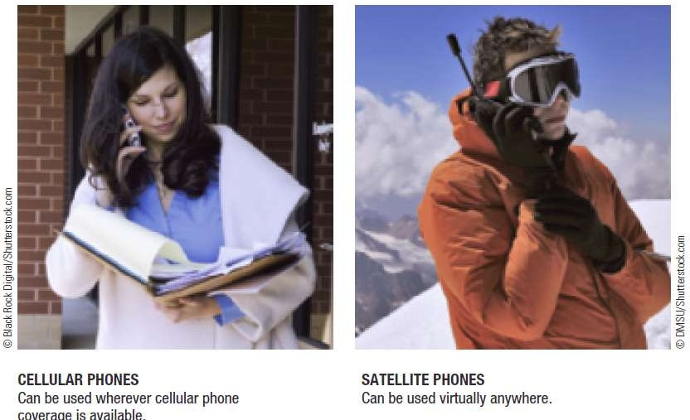

Networking Applications

Slide 7
Networking Applications
Television and Radio Broadcasting
Still used to deliver TV and radio content to the public
Other networks involved with television content delivery are cable TV networks, satellite TV networks, and private closed-circuit television systems
Global Positioning System (GPS) Applications
Uses satellites and a receiver to determine the exact geographic location of the receiver
GPS receivers
Commonly used by individuals to determine their geographic location

Slide 8
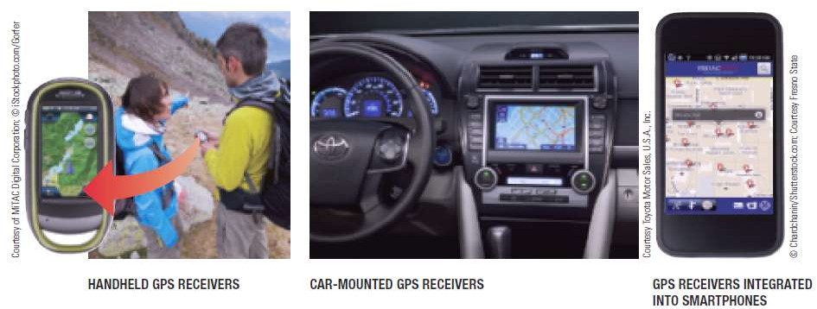
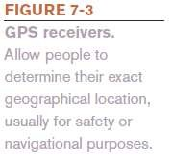
Networking Applications
GPS receivers
Used on the job by surveyors, farmers, and fishermen
Used to guide vehicles and equipment
Used by the military to guide munitions and trucks, and to track military aircraft, ships, and submarines

Slide 9
Networking Applications
Monitoring Systems
Use networking technology to determine the current location or status of an object
RFID-based Systems (Radio Frequency Identification)
Monitor the status of objects (inventory management, secure access to buildings)
GPS-based Monitoring Systems
Monitor the physical location of objects
Vehicle and child monitoring systems
Electronic Medical Monitors
Home healthcare

Slide 10
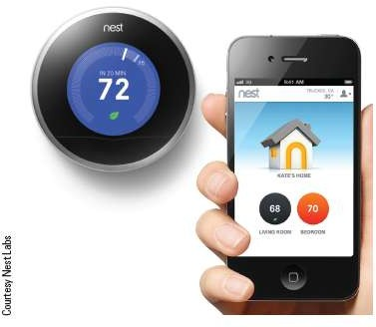
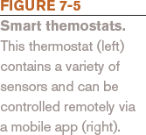
Networking Applications
Sensors are used in some monitoring systems
Sensor networks
Home automation (smart thermostats, etc.)

Slide 11
Networking Applications
Multimedia Networking
Distributing digital multimedia content, typically via a home network
Necessary networking capabilities are often built into devices being used
Might need to use multimedia networking device such as a digital media receiver or digital media streamer
Placeshifting Content
Allows individuals to view multimedia content at a
more convenient location, i.e., Slingbox

Slide 12
Networking Applications
Videoconferencing, Collaborative Computing, and Telecommuting
Videoconferencing
Use of computers, video cameras, microphones, and networking technologies to conduct face-to-face meetings over a network
Telepresence Videoconferencing
A setup that more closely mimics a real-time meeting environment

Slide 13
Networking Applications
Collaborative Computing (workgroup computing)
Enables individuals to work together on documents and projects
Telecommuting
Individuals work from a remote location (usually home) and communicate with their places of business and clients using networking technologies
Allows for employee flexibility

Slide 14
Networking Applications
Telemedicine
Use of networking technology to provide medical information and services
Remote monitoring and consultations
Remote diagnosis
Telesurgery
Robot assisted surgery where doctor’s physical location is different from the patient’s and robot’s
Will be needed for long-term space exploration

Slide 15
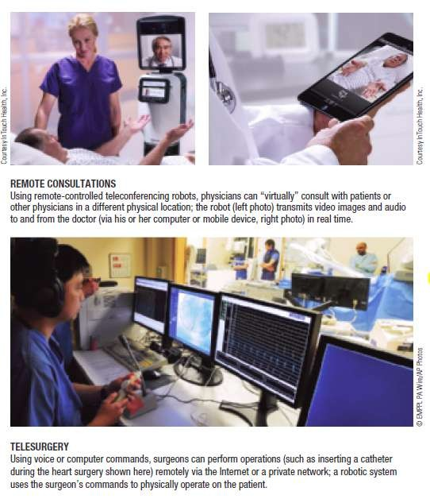

Networking Applications

Slide 16
Network Characteristics
Wired vs. Wireless Networks
Wired
A network in which computers and other devices are
physically connected to the network with cables
Found in schools, businesses, and government facilities
Wireless
A network in which computers and other devices are connected to the network without physical cables
Data is typically sent via radio waves
Found in homes, schools, and businesses

Slide 17
Network Characteristics
Network Topologies: Indicate how the devices in the network are arranged
Star Networks
All networked devices connect to a central device/server
If the central device fails, the network cannot work
Bus Network
Uses a central cable to which all network devices connect
Mesh network
Multiple connections among the devices on the network so that messages can take any of several possible paths

Slide 18
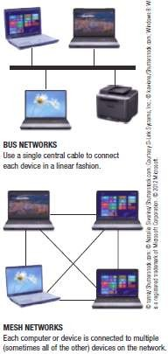
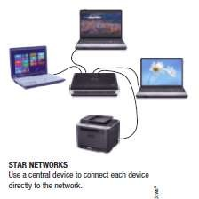
Network Characteristics

Slide 19
Network Characteristics
Network Architectures
Client-Server Networks
Client
Computer or other device on the network that requests and utilizes network resources
Server
Computer dedicated to processing client requests

Slide 20
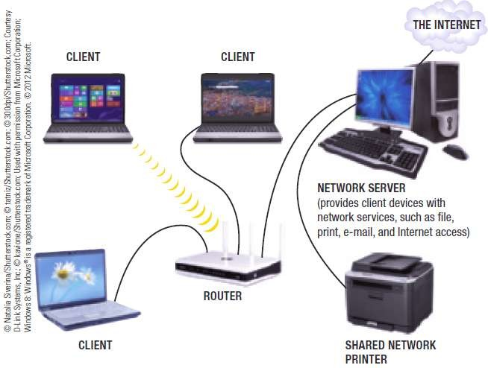
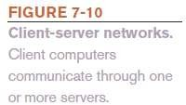
Network Characteristics

Slide 21
Network Characteristics
Peer-to-Peer (P2P) Networks
Central server is not used
All computers on the network work at the same
functional level
Users have direct access to the computers and devices attached to the network
Less complicated and less expensive to implement than client-server networks
Internet P2P Computing
– Content is exchanged over the Internet directly between users

Slide 22
Network Characteristics
Network Size and Coverage Area
Personal Area Networks (PANs)
Connect an individual’s personal devices (bluetooth)
– Devices must be physically located close together
Local Area Networks (LANs)
Connect devices located in a small geographic area (home/office network)
Metropolitan Area Networks (MANs)
Cover a metropolitan area such as a city or county
Wide Area Networks (WANs)
Cover a large geographic area (internet)
Two or more LANs connected together

Slide 23
Network Characteristics
Intranets and Extranets
Intranet
Private network designed to be used by an
organizations’ employees; set up like the Internet
Extranet
Company network accessible by authorized outsiders
Virtual Private Networks (VPNs)
Private, secure path over the Internet that provides authorized users a secure means of accessing a private network via the Internet
Uses tunneling and special encryption technology

Slide 24
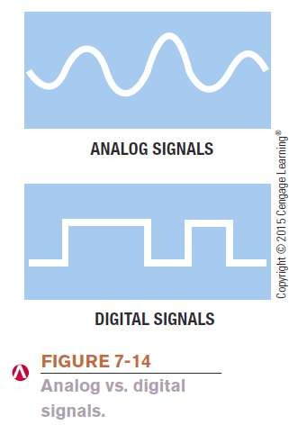
Data Transmission Characteristics
Bandwidth
The amount of data that can be transferred in a given period of time
Measured in bits per second (bps), Kbps (thousands), Mbps (millions ), or Gbps (billions)
Analog vs. Digital Signals
Data represented by two discrete states: 0s and 1s
Conventional telephone systems use
analog signals
Represent data with continuous waves

Slide 25
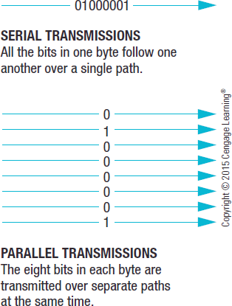

Data Transmission Characteristics
Transmission Type and Timing
Serial
Data sent one bit at a time, one after another, along a single path
Parallel
Data sent at least one byte at time with each bit in the byte taking a different path

Slide 26
Data Transmission Characteristics
Synchronous Transmission
Blocks of data are transferred at regular, specified intervals
Most data transmissions within a computer and over a
network are synchronous
Asynchronous Transmission
Data is sent when ready without being synchronized
Start bits and stop bits used to identify the bits that belong in each byte
Isochronous Transmission
Data sent at the same time as other, related, data

Slide 27
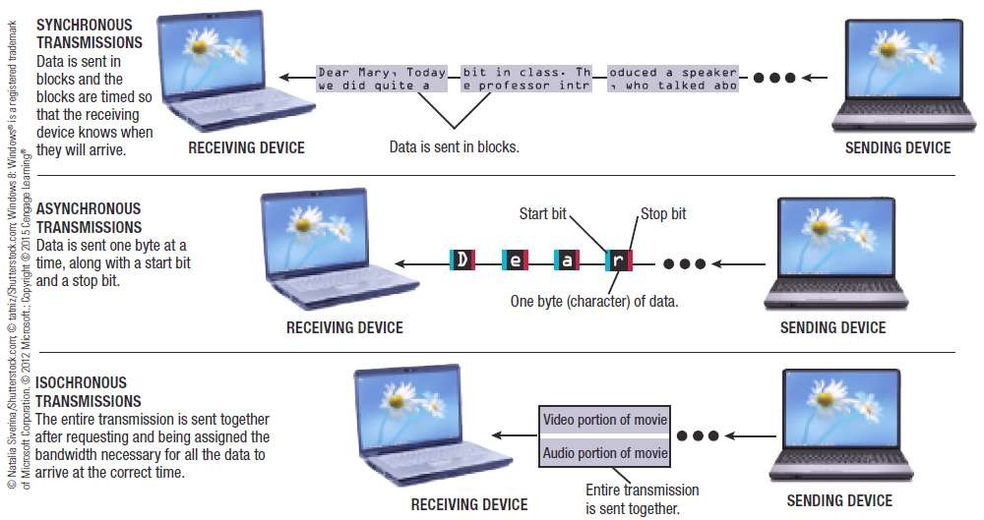

Data Transmission Characteristics

Slide 28
Data Transmission Characteristics
Simplex Transmission
Data travels in a single direction only
Half-Duplex Transmission
Data travels in either direction but only one way at a time
Full-Duplex Transmission
Data travels in both directions at the same time

Slide 29
Data Transmission Characteristics
Delivery Method
Circuit-Switching
Dedicated path over a network is established between sender and receiver; all data follows that path
Packet-Switching
Messages are separated into small units called packets and travel along the network separately; packets are reassembled once destination is reached
Broadcasting
Data is sent out to all other nodes on the network and retrieved only by the intended recipient; primarily used with LANs (Live and tv signal)

Slide 30
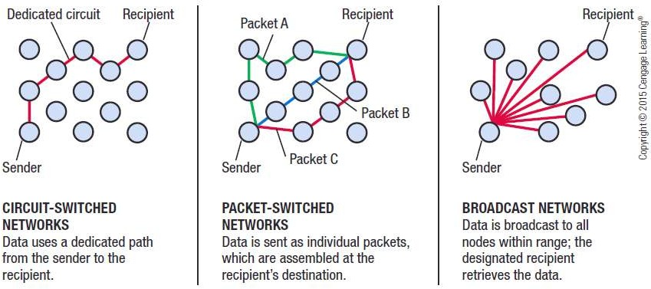
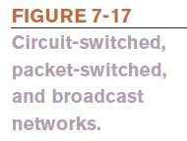
Data Transmission Characteristics

Slide 31
Networking Media
Wired Networking Media
Twisted-Pair Cable
Pairs of insulated wires twisted together
Used for telephone and network connections (LANs)
Coaxial Cable
Thick center wire surrounded by insulation
Used for computer networks and cable television delivery
Fiber-Optic Cable
Utilizes hundreds of thin transparent clear glass or plastic fibers over which lasers transmit data as light
Used for high-speed communications

Slide 32
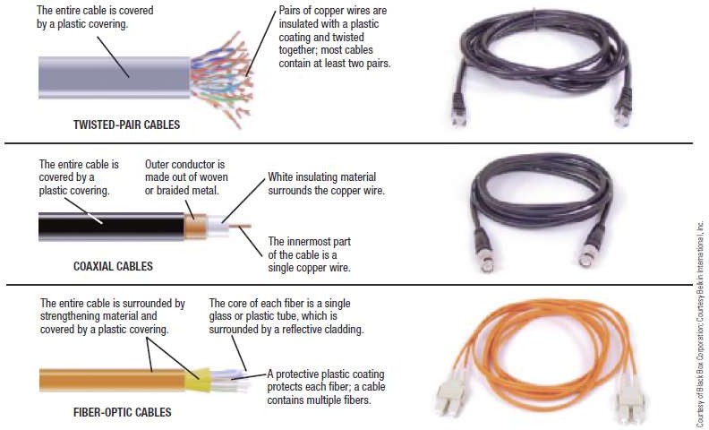

Networking Media

Slide 33
Networking Media
Wireless Networking Media
Data is sent through the airwaves using radio signals
The Electromagnetic and Wireless Spectrum
Radio frequencies are assigned by the FCC and are measured in hertz (Hz)
The electromagnetic spectrum is the range of common electromagnetic radiation (energy)
Different parts of the spectrum have different properties, which make certain frequencies more appropriate for certain applications
FCC: Federal Communication Commission

Slide 34
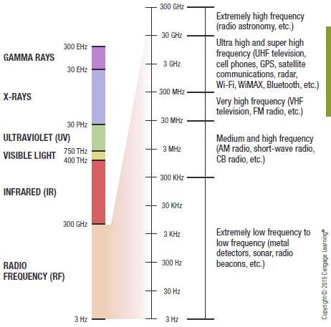
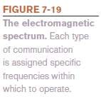
Networking Media

Slide 35
Networking Media
Frequencies assigned to an application usually consist of a range of frequencies to be used as needed
Most wireless networking applications use frequencies in the RF band at the low end of the spectrum—up to 300 GHz
Often called the wireless spectrum
The 900 MHz, 2.4GHz, 5 GHz, and 5.8 GHz frequencies are within an unlicensed part of the spectrum and can be used by any product or individual
Cordless landline phones, garage door openers, Wi-Fi, WiMAX, and Bluetooth

Slide 36
Networking Media
Cellular Radio Transmissions
Use cellular towers within honeycomb-shaped zones called cells
Calls are transferred from cell tower to cell tower as the individual moves
Cell tower forwards call to the MTSO (mobile telephone switching office)
MTSO routes call to the recipient’s phone
Data sent via cell phones works in similar manner
The speed of cellular radio transmissions depends on the type of cellular standard being used

Slide 37
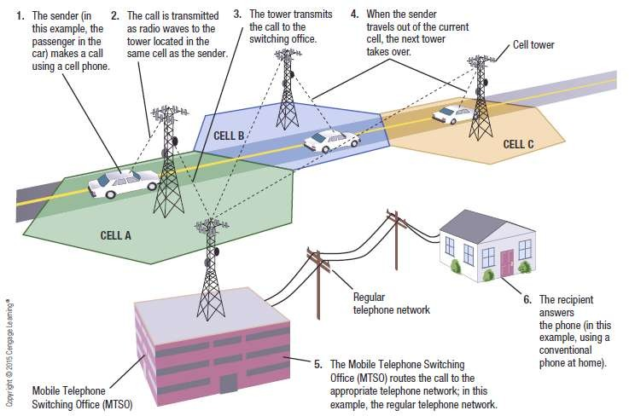

Networking Media

Slide 38
Networking Media
Microwave and Satellite Transmissions
Microwaves
High-frequency radio signals that are sent and received using microwave stations or satellites
Signals are line of sight, so microwave stations are usually built on tall buildings, towers, mountaintops (old tv antennas used to capture microwave signal)
Microwave stations
Earth-based stations that transmit signals directly to each other within a range of 30 miles
Stations designed to communicate with satellites (television and internet services) are called satellite dishes

Slide 39
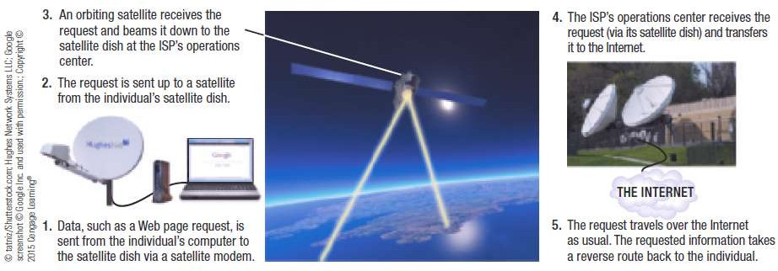

Networking Media

Slide 40
Communications Protocols and Networking Standards
Protocol
A set of rules for a particular situation
Communications Protocol
A set of rules that determine how devices on a network communicate
Standard
A set of criteria or requirements approved by a recognized standards organization
Address how networked computers connect/communicate
Needed to ensure products can work with other products

Slide 41
TCP/IP and Other Communications Protocols
TCP/IP
Most widely used communications protocol
Consists of two protocols
Transmission Control Protocols (TCP)
Responsible for delivery of data
Internet Protocols (IP)
Provides addresses and routing information
Uses packet switching to transmit data
TCP/IP support is built into almost all operating systems and IP addresses are used to identify computers and devices on networks

Slide 42
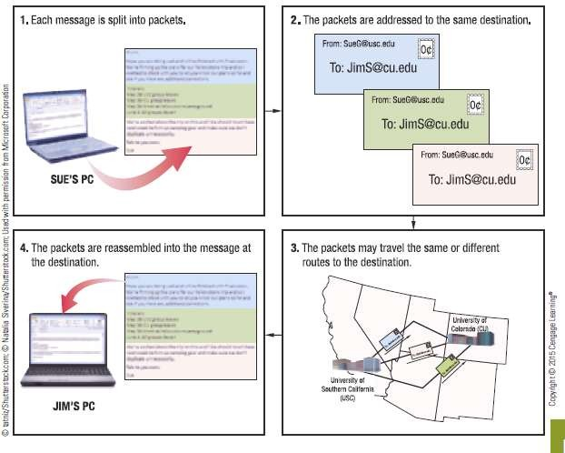

TCP/IP and Other Communications Protocols

Slide 43
TCP/IP and Other Communications Protocols
Other Protocols
HTTP (Hypertext Transfer Protocol) and HTTPS (Secure Hypertext Transfer Protocol)
Used to display Web pages
FTP (File Transfer Protocol)
Used to transfer files over the Internet
SMTP (Simple Mail Transfer Protocol and POP3 (Post Office Protocol)
Used to deliver e-mail over the Internet

Slide 44
Ethernet (802.3)
Ethernet (802.3)
Most widely used standard for wired networks
Typically used with LANs that have a star topology
Works with twisted-pair, coaxial, and fiber-optic cabling
Most common today are Fast Ethernet, Gigabit Ethernet, and 10 Gigabit Ethernet
Power over Ethernet (PoE) (device gets both power and network connection info on a single cable.)
G.hn protocol
existing home wiring—phone lines, power lines, and coaxial cable
Broadband over Powerline (BPL)
Designed to deliver broadband Internet to homes via the existing outdoor power lines

Slide 45
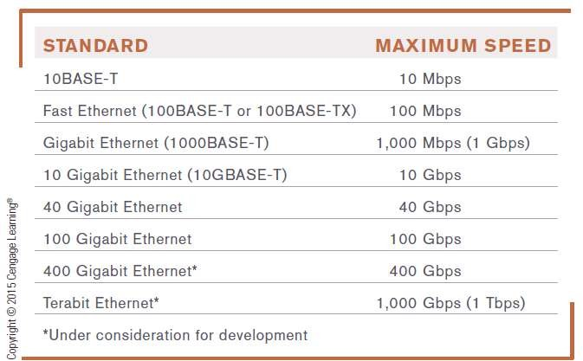

Ethernet (802.3)

Slide 46
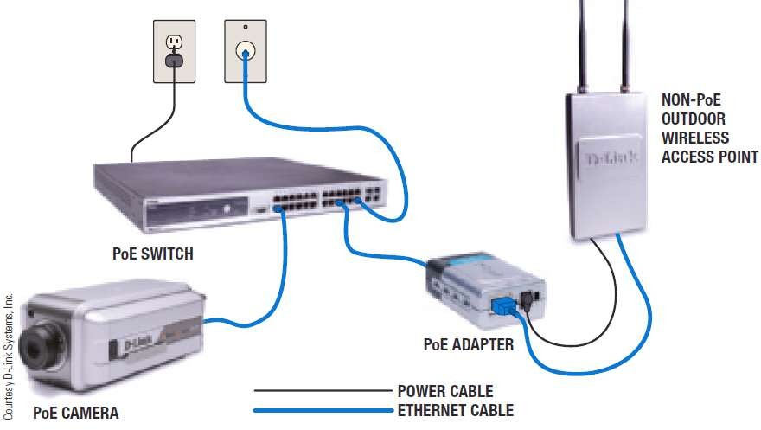

Ethernet (802.3) PoE

Slide 47
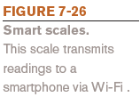
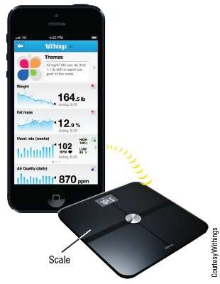
Wi-Fi (802.11)
Wi-Fi (802.11)
A family of wireless networking standards using IEEE standard 802.11
Current standard for wireless networks in homes and offices (wireless Ethernet)
Built into many everyday objects
today
Designed for medium-range transmission; speed and distance depends on Wi-Fi standard being used, solid objects in the way, interference, etc.

Slide 48
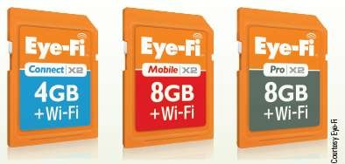
Technology and You Box
Wi-Fi SD Cards
Upload photos wirelessly and automatically from camera to computer, mobile device, or cloud photo service
Some include location information
Some sync photos and videos to cloud account
Can share photos quickly with others as well as have backups

Slide 49

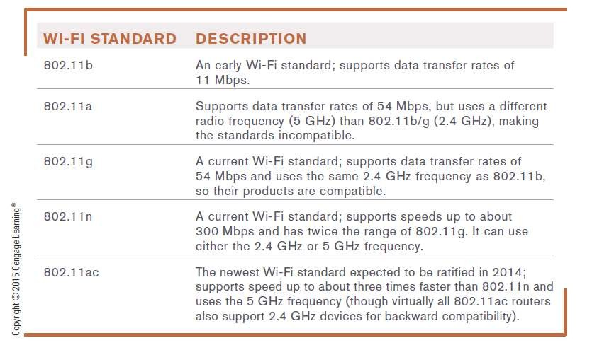
Wi-Fi (802.11)

Slide 50
WiMAX (802.16)
WiMAX (802.16)
Standards for longer range wireless networking connections, typically MANs
Fixed WiMAX
Designed to provide Internet access fixed locations (hotzones)
Typical hotzone radius is between 2 and 6 miles
Possible to provide coverage to an entire city by using multiple WiMAX towers
Mobile WiMAX
Mobile version of the standard

Slide 51
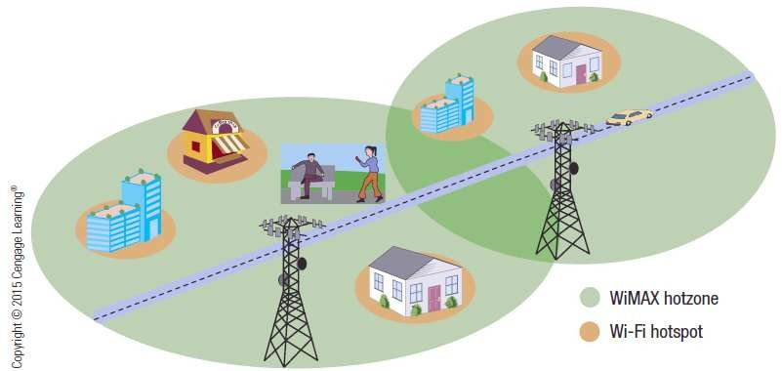
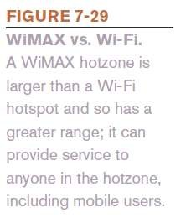
WiMAX (802.16)

Slide 52
Cellular Standards
Cellular Standards
First Generation
Analog and voice only
2G (Second Generation)
Digital, both voice and data, faster
3G and 4G networks
Current standards
Use packet switching
3G speeds are between 1 and 4 Mbps
4G speeds currently range from about 3 to 15 Mbps

Slide 53
Bluetooth, Ultra Wideband (UWB), and Other Short-Range Wireless Standards
Bluetooth
Networking standard for very short-range wireless connections
Bluetooth 4.0 (Bluetooth Smart) is low energy so can run for years on small battery
Wireless USB
Wireless version of USB designed to connect peripheral devices
Wi-Fi Direct
Standard for connecting Wi-Fi devices directly, without using a router or an access point

Slide 54
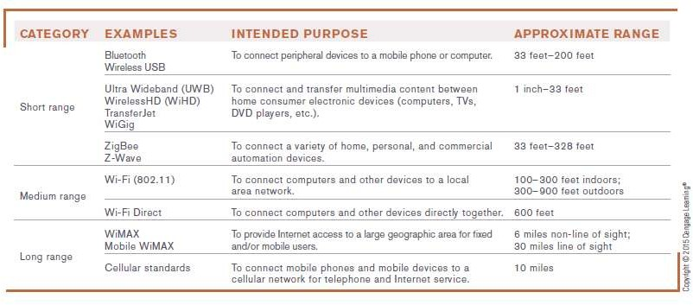

Bluetooth, Ultra Wideband (UWB), and Other Short-Range Wireless Standards

Slide 55
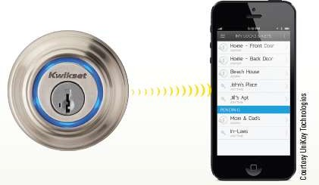
How It Works Box
Smart Homes
Home automation
Use Z-Wave, Bluetooth, Wi-Fi or other wireless
standards to control lights, door locks, thermostats, etc.
Smart door locks can be unlocked via proximity sensors and Bluetooth 4.0
Can send temporary keys to others
Can check on status of
locks and keys online

Slide 56
Networking Hardware
Network Adapter
Used to connect a computer to a network
Also called network interface card (NIC) when in the form of an expansion card
Modem
Device that enables a computer to communicate overanalog networking media
Term is often used interchangeably with network adapter
Most computers and mobile devices today come with a built-in network adapter and/or modem

Slide 57
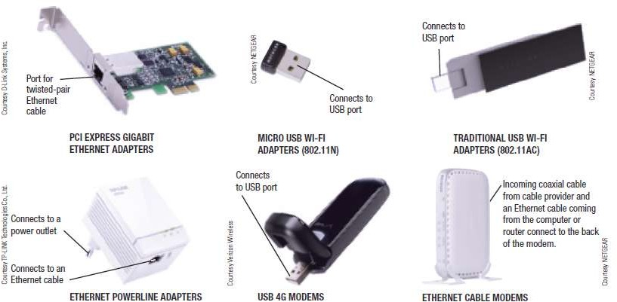

Networking Hardware

Slide 58
Networking Hardware
Switch
Central device that connects devices in a wired network but only sends data to the intended recipient
Hub – similar but sends data to all recipients
Router
Connects multiple networks: two LANs, two WANS, LAN and the Internet
Passes data to intended recipient only
Routes traffic over the Internet
Wireless Access Point (WAP)
Device used to grant network access to wireless client devices

Slide 59
Networking Hardware
Wireless Router
Typically connects both wired and wireless devices to a network and to connect the network to the Internet
Often integrates a switch, router, and wireless access point
Bridge
Used to connect two LANs together
In a home network, wirelessly connects a wired device to the network

Slide 60
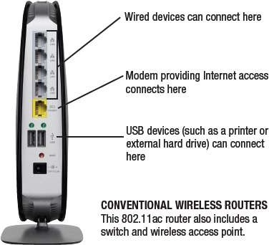
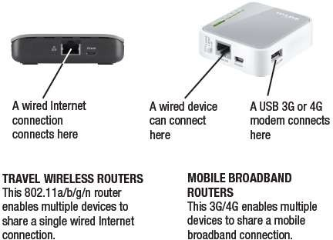
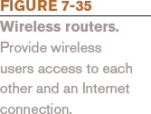
Networking Hardware

Slide 61
Networking Hardware
Repeaters
Amplify signals along a wired/wireless network
Range Extenders
– Repeaters for a wireless network
Antennas
Devices used for receiving or sending radio signals
Some network adapters can use an external antenna
Can be directional or omnidirectional
Strength measured in decibels (dB)

Slide 62
Networking Hardware
Multiplexer
Combines transmissions from several different devices to send them as one message
Concentrator
Combines messages and sends them via a single transmission medium in such a way that all of the messages are simultaneously active

Slide 63
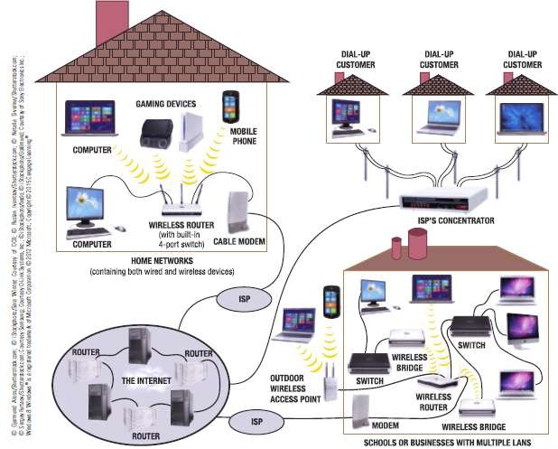

Networking Hardware

Slide 64
Summary
Networking Concepts
Networking Applications
Telecom Industry
Videoconferencing
Network Characteristics:
Types of networks
Network Topologies
Network Architectures
Network Size & Coverage Area

